Slide 1

SUPERSTORE ANALYSIS
DEEPA RATHEESH

Slide 2
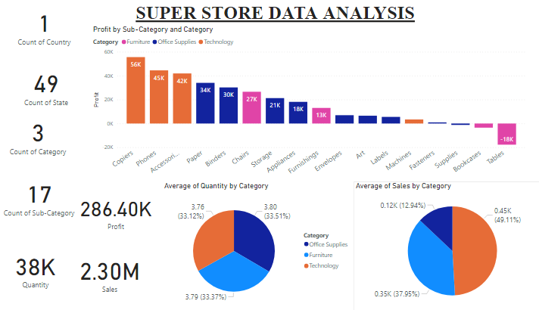

Slide 3
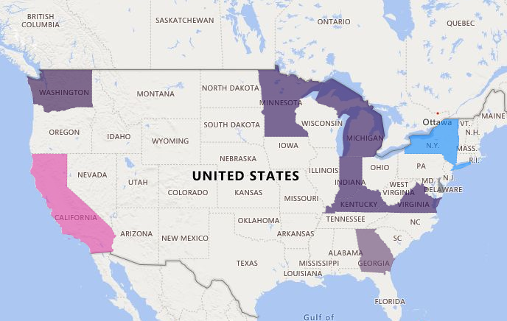
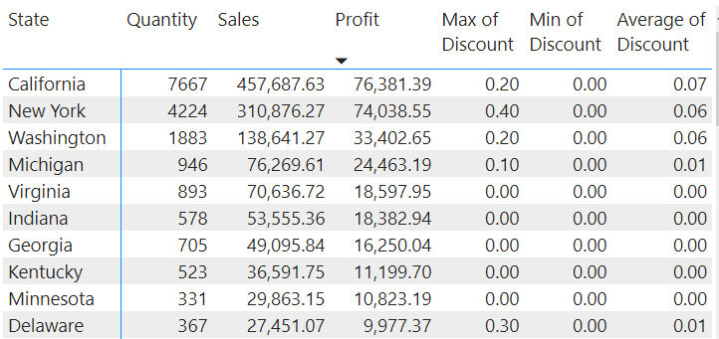
PROFIT ANALYSIS
*Highest profit is for state California
*Top 10 profit making states contribute to 48% of the overall quantity of items sold and 54% of the sales
*California and New York alone contribute more than 50% of overall Profit
TOP 10 PROFIT MAKING STATES

Slide 4
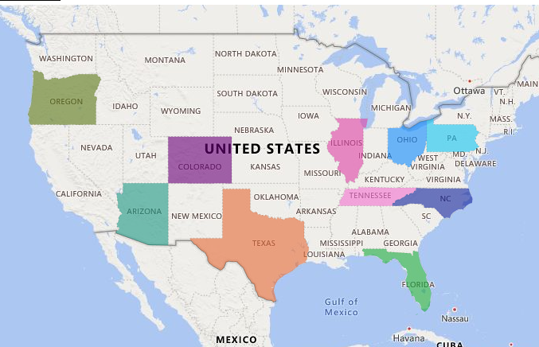
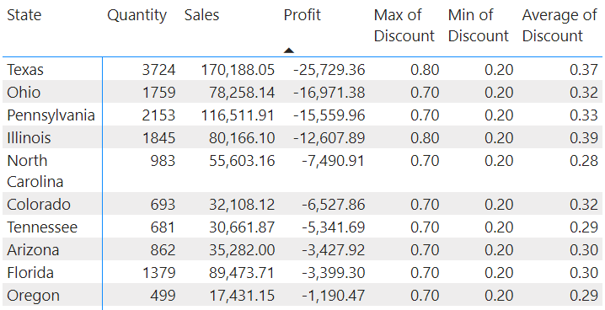
PROFIT ANALYSIS
*10 states have negative profit & overall profit reduce by 25% due to negative profit made by those 10 states
*Texas is making highest negative profit
*Negative profit-making states has average discount of 28% to 39% and Maximum discount of 70% to 80%
*Only the negative profit-making states has minimum 20% discount
NEGATIVE PROFIT-MAKING STATES

Slide 5
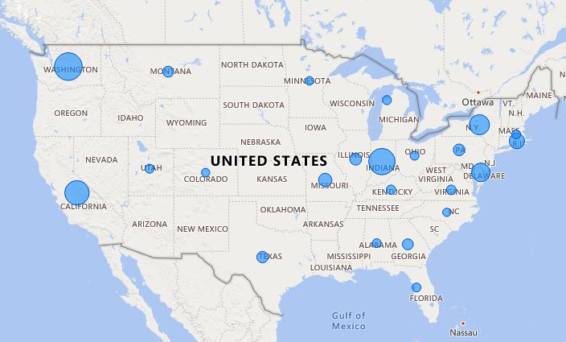
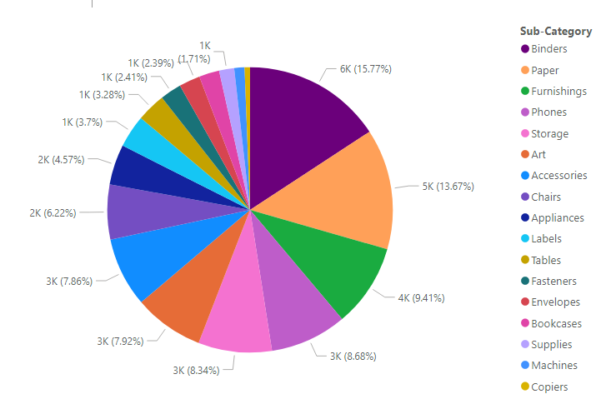
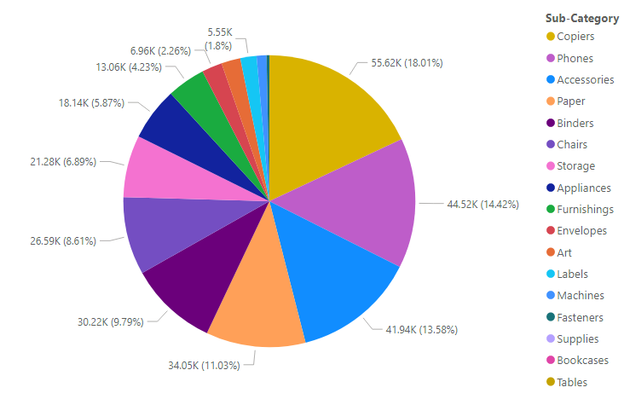
COPIER SELLING AREA
Profit ANALYSIS
Binders, Paper, Furnishing and Phones make up to 48% of overall quantity of items sold
Copiers, Phones and Accessories alone contribute to 46% of overall profit
Copiers made a profit of $55617 by selling 234 units mainly in eastern states
Out of 49 states, Copiers is sold only in 23 states which is the least followed by machines in 25 states
PROFIT
QUANTITY

Slide 6
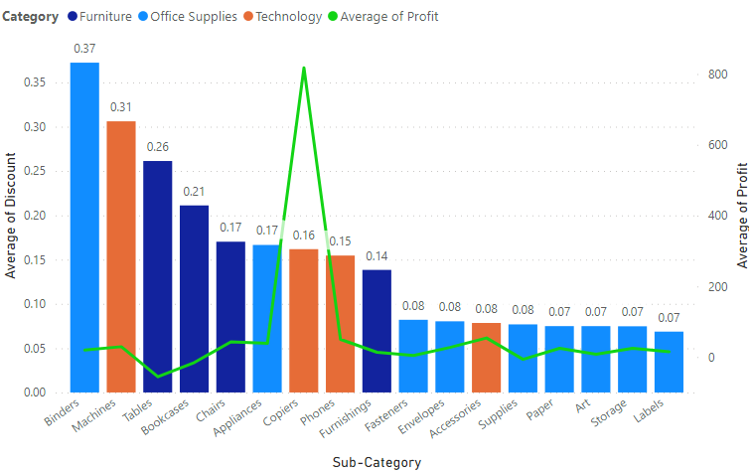
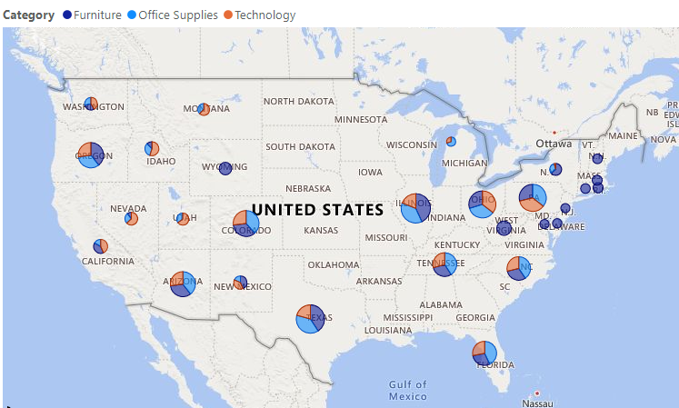
Average discount and profit
Binders have the highest average discount
Except for copiers , the average profit for all others are less than $50
In furniture category table has the maximum average discount
Tables, supplies and bookcases have negative average profit
In the eastern side, the main purchasing category is furniture
In the places having high average discount, all three categories share almost equal percentages
Avg Discount in various states and categories

Slide 7
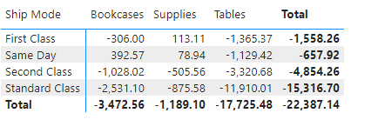
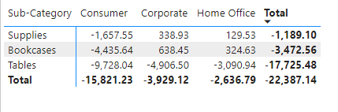
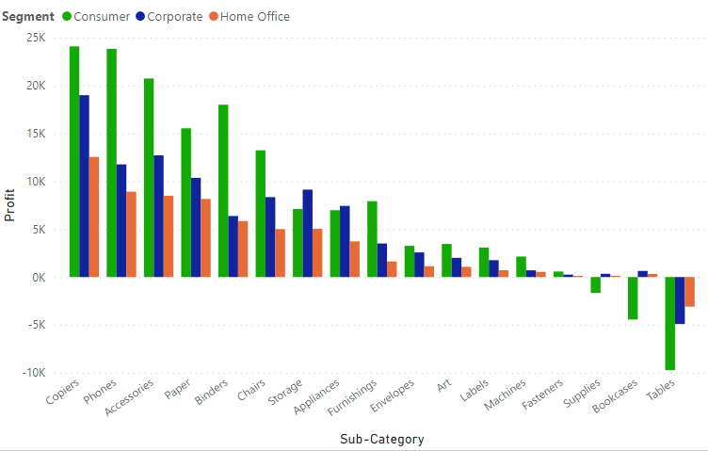
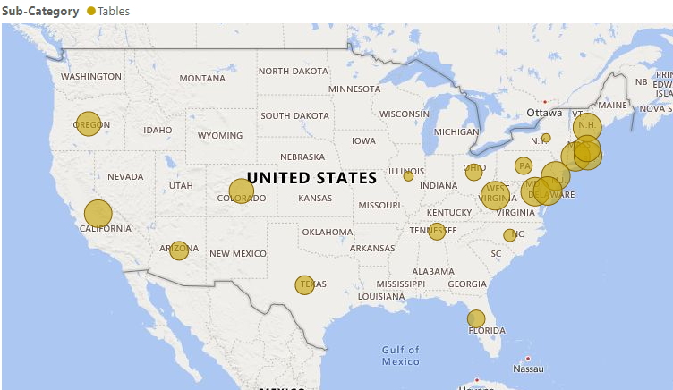
TABLE
The standard class ship mode is having the highest negative profit
For Tables, the negative profit is concentrated around the eastern area
Table have negative profit for all 3 segments
NEGATIVE PROFIT-MAKING AREA
Profit for each segment and subcategory

Slide 8
CONCLUSION
California and New York market is contributing to 20% of purchase and more than 50% of overall profit
The average discount in the negative profit-making states are between 28% and 39%
Copiers, Phones and Accessories alone contribute to 46% of overall profit and should be promoted more to increase the quantity of purchase
Copiers and machines are sold only on 50% of country even though both are profit making items
Tables, supplies and bookcases have negative profit
Tables have negative profit in all 3 segments and all 4 ship modes

